Slide 1









EOCap4Africa 8 Raster Processing
a) Data Acquisition, Cloud Handling & Mosaicing basics

Slide 2

Learning objectives
Learn which preprocessing steps matter in a remote sensing study
Understand the theoretical basics of cloud masking and mosaicing
Practice how to acquire Sentinel-2 data via Sentinel Hub

Slide 3
Why do we preprocess raster data?
Clouds and shadows obscure surface features
Processing raw data improves accuracy for analysis
Combining multiple images provides better coverage
Sentinel-2 tiles do not always align perfectly

Slide 4
Common preprocessing steps in GIS
Cloud masking – Remove unwanted cloud pixels
Mosaicing – Merge multiple Sentinel-2 tiles
Clipping – Focus on an area of interest
Resampling – Adjust pixel resolution
Reprojection – Align coordinate systems for consistency

Slide 5
Order of preprocessing steps
Cloud masking first prevents contaminated pixels from affecting the mosaic
Mosaicing before clipping ensures a continuous dataset before selecting an AOI
Reprojection after clipping reduces unnecessary transformations on large datasets
Resampling last ensures final compatibility with the analysis requirements
QGIS offers great tools for all of these steps!

Slide 6
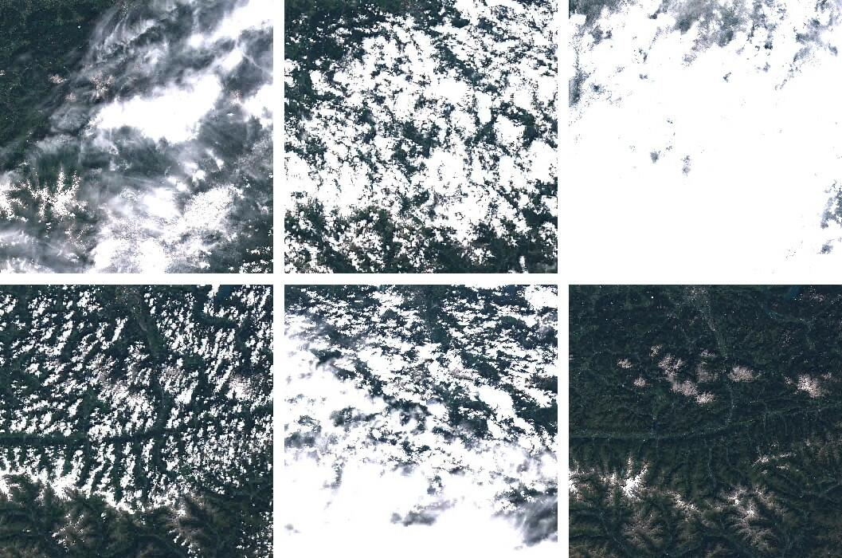
Cloud coverage on Sentinel-2 Data
(Ungar 2017)

Slide 7
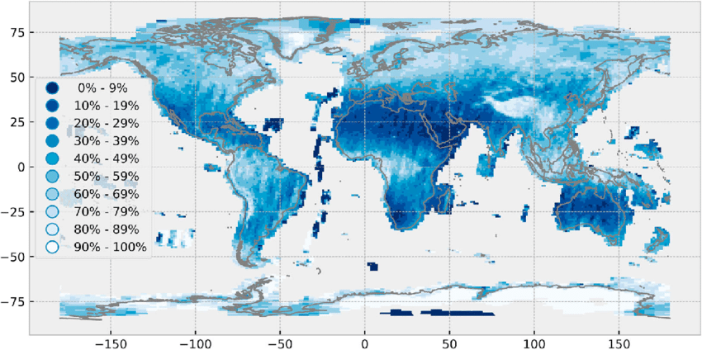
Cloud coverage on Sentinel-2 Data
Global spatial distribution of the average cloud cover of Sentinel-2
(Sudmanns et al. 2019)

Slide 8
What is mosaicing?
Mosaicing is the process of merging multiple raster tiles into a seamless image
Why is it needed?
Sentinel-2 and other satellite imagery come in separate tiles
Large study areas require multiple images to cover the entire region
Merging helps remove gaps and ensures spatial continuity
How does it work?
Overlapping areas are blended using pixel values
NoData values are handled to avoid gaps
The output is a single, continuous raster dataset

Slide 9
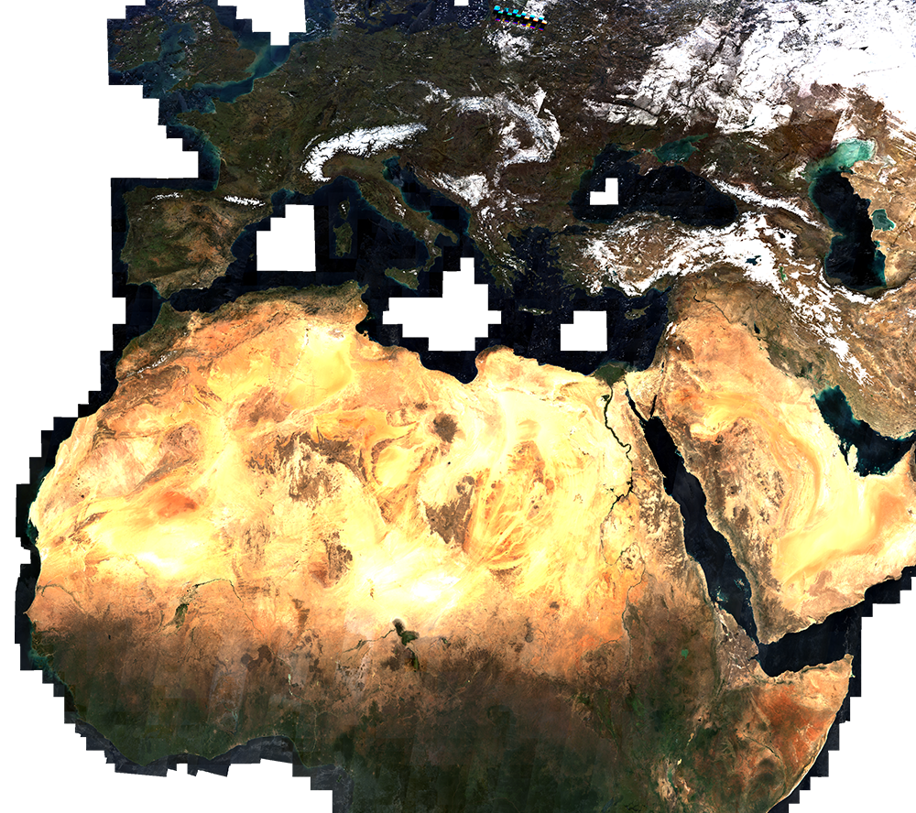
Sentinel-2 Mosaic
Showing southern Europe and northern Africa
(Sentinel Hub n.d.)

Slide 10
Recap: Accessing Sentinel-2 data
https://browser.dataspace.copernicus.eu
General workflow:
Visit the Sentinel Browser
Define Area of Interest (AOI) using a bounding box or shapefile
Choose Sentinel-2 L2A for atmospherically corrected data
Filter by date range and cloud cover
Download in GeoTIFF format for QGIS compatibility

Slide 11
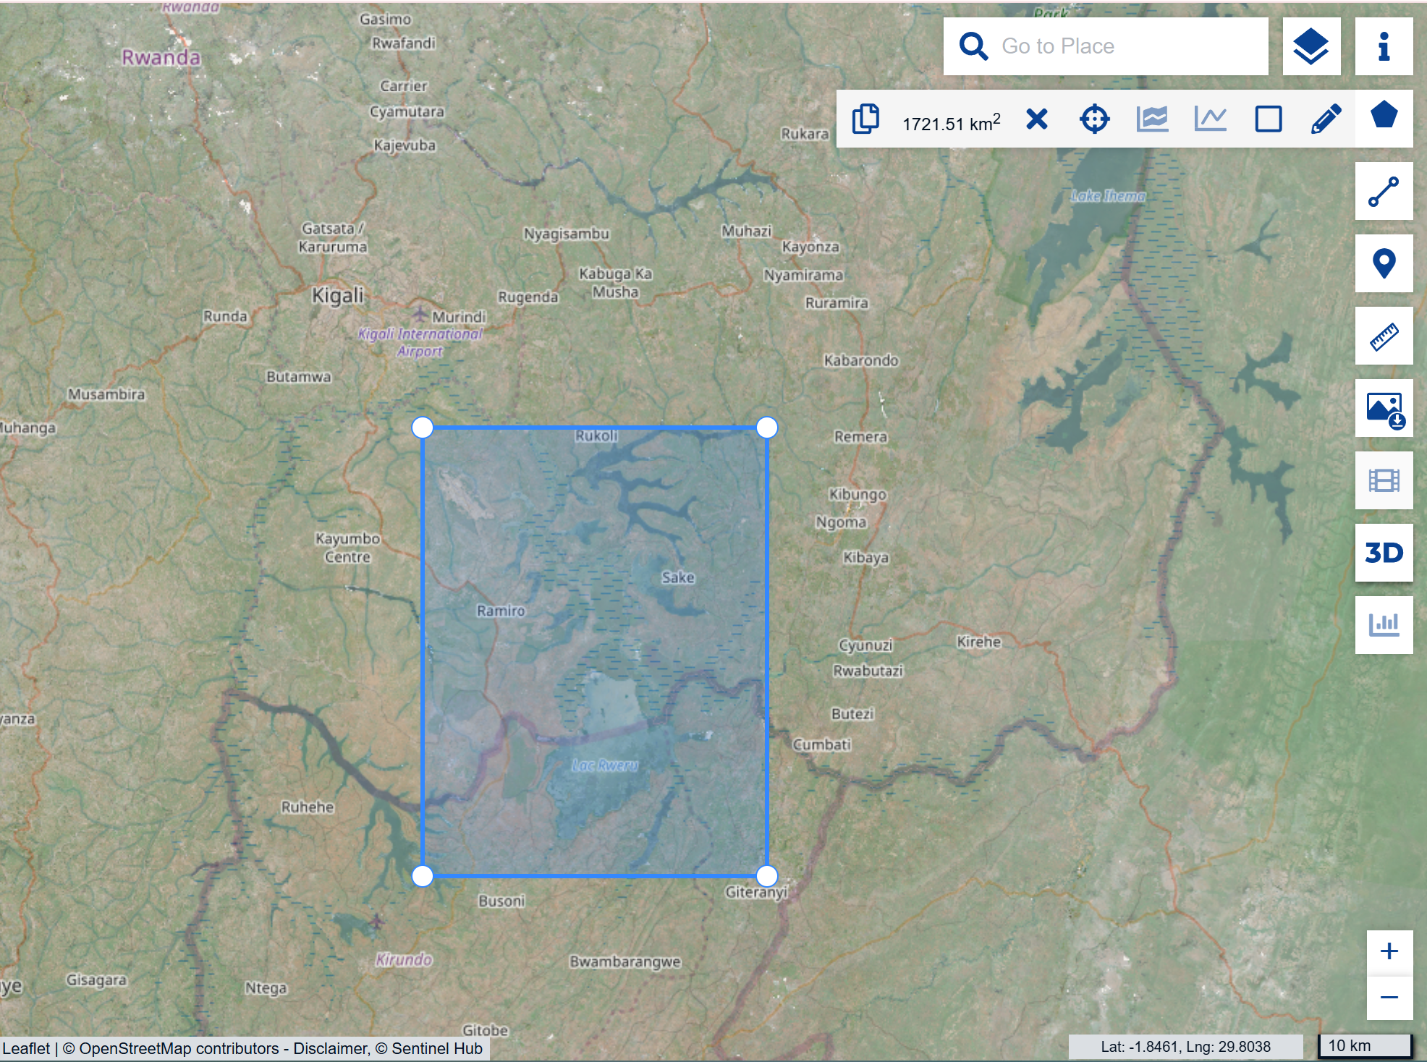
Recap: Accessing Sentinel-2 data
Select the area of interest (AOI)
In this case, I choose wetlands in Rwanda

Slide 12
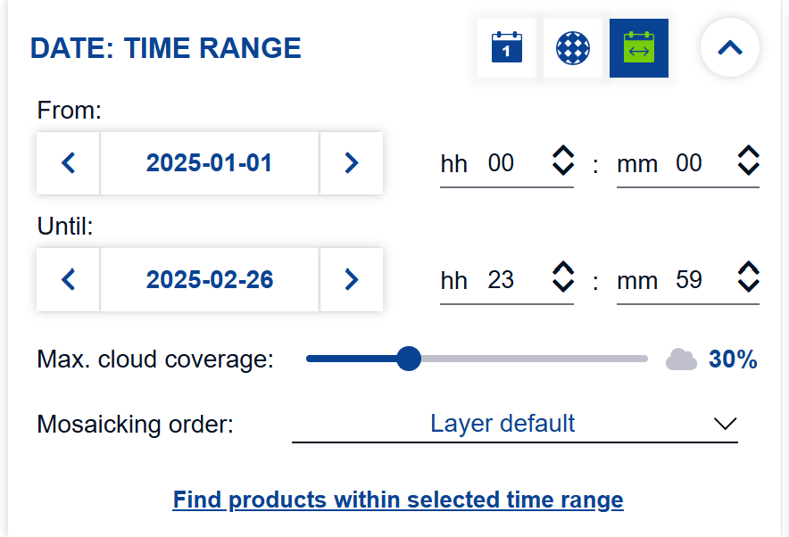
Recap: Accessing Sentinel-2 data
Select date of image acquisition, cloud cover and mosacking order suitable to your study

Slide 13
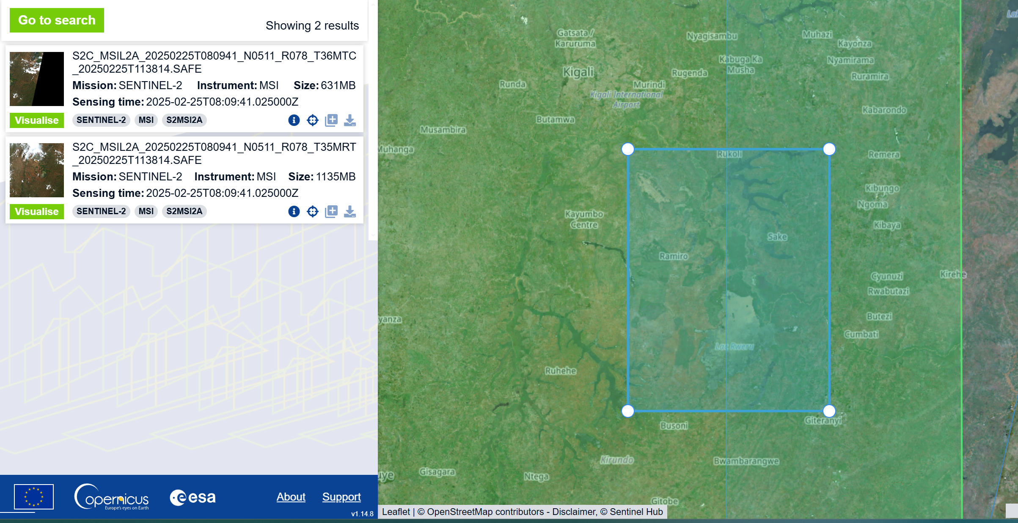
Recap: Accessing Sentinel-2 data
Compare results and choose the image that best covers your AOI

Slide 14
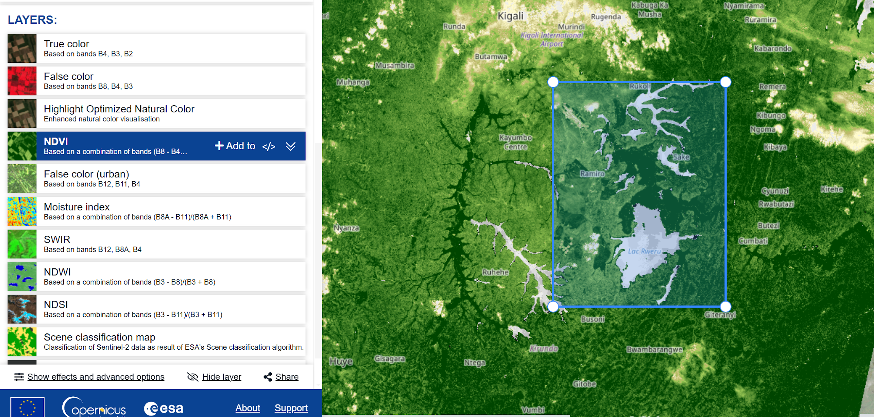
Recap: Accessing Sentinel-2 data
In the layers tab you can either choose the RGB Image or finalised analysis products such as the NDVI

Slide 15
Recap: Accessing Sentinel-2 data
Finally, if you are logged in to your account, you can download the scene.
Download a Sentinel-2 scene of your liking by following the steps outlined before.
Think of a study in which this Scene might be useful.

Slide 16
Summary & key takeaways
Sentinel-2 data is easily accessible via Copernicus Browser
Cloud cover is essential for optical satellite imagery
Mosaicing combines multiple tiles for seamless analysis
QGIS provides user-friendly tools for raster preprocessing

Slide 17
Sources
Sudmanns, M., Tiede, D., Augustin, H., & Lang, S. (2019). Assessing global Sentinel-2 coverage dynamics and data availability for operational Earth observation (EO) applications using the EO-Compass. International Journal of Digital Earth, 13(7), 1-17. https://doi.org/10.1080/17538947.2019.1572799
Ungar, J. (2017, March 6). Sentinel-2 cloudless. EOX. Retrieved from https://eox.at/2017/03/sentinel-2-cloudless/
Sentinel Hub. (n.d.). True color mosaic – Sentinel-2 120m Mosaic. Retrieved from https://custom-scripts.sentinel-hub.com/custom-scripts/sentinel2-120m-mosaic/true-color/

Slide 18






Thank you for your attention!
Dr. Insa Otte, Hanna Schulten
(on behalf of the EOCap4Africa Team)
and colleagues
insa.otte@uni-wuerzburg.de

