Slide 1









EOCap4Africa 1 How to conduct a Remote Sensing case study
b) Selecting data for a Remote Sensing case study

Slide 2

Learning objectives
Understand why data selection is crucial for remote sensing studies
Differentiate between primary satellite data and ancillary data
Identify key sources for obtaining ancillary data

Slide 3
Why data selection matters
A case study is only as good as the data behind it!
Selecting the right datasets impacts
Accuracy – Poor-quality or missing data weakens results
Interpretability – More context = better understanding
Comparability – Allows for multi-source validation
For Example:
A Sentinel-2 NDVI map alone shows vegetation health.
Adding land-use data reveals whether changes are due to agriculture, deforestation, or urban expansion

Slide 4
Primary vs. Ancillary data
Primary data (Satellite imagery)
The main remote sensing dataset (e.g., Sentinel-2, Landsat)
Provides spectral and spatial information
Useful for vegetation analysis, land cover change, and water monitoring
Ancillary data (Supporting data)
Additional data improving context and accuracy
Often vector data (points, lines, polygons) but can also include tabular or raster data
Helps answer the why behind observed patterns

Slide 5
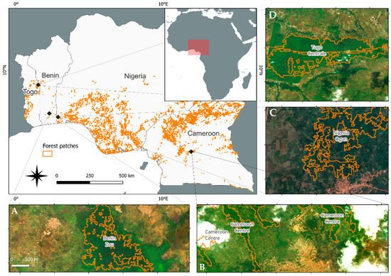
Example using primary and ancillary data
Primary data (Satellite imagery)
Provides the background of the image
Visualises the study area (forest/no forest)
Ancillary data (Supporting data)
Vector Data
Highlights where forest patches are located
Used for comprehensiveness
(Wingate et al. 2022)

Slide 6
Key types of ancillary data
1) Administrative boundaries
Used to define study areas and analyze changes at national, regional, or local scales
Sources: OpenStreetMap, GADM, UN datasets, https://data.humdata.org/
2) Land use & land cover (LULC) data
Helps differentiate natural vegetation vs. agricultural fields vs. urban areas
Sources: ESA WorldCover, Copernicus Land Monitoring, MODIS LULC

Slide 7
Key types of ancillary data
3) Infrastructure data (roads, buildings, etc.)
Essential for understanding urbanisation, accessibility, and human impact
Sources: OpenStreetMap, Global Roads Inventory Project
4) Field & In situ data
Ground-based measurements help validate satellite results
Examples: GPS-based vegetation surveys, soil samples
Sources: Locally collected field data, scientific research initiatives

Slide 8
Key challenges of ancillary data
1) Data quality & resolution issues
Low-resolution land cover maps may not align with high-resolution satellite data
2) Inconsistent or outdated data
Administrative boundaries and infrastructure change over time.
3) Projection & format compatibility
Data often comes in different coordinate systems (WGS84 vs. UTM)
4) Ethical and privacy concerns
Some datasets require permissions, payments or are only accessible for government bodies

Slide 9
Best practices for integrating ancillary data
Always check metadata
Understand resolution, date, and projection
Align spatial projections
Ensure all layers use the same coordinate system.
Cross-check multiple sources
Avoid relying on a single dataset
Use authoritative data providers
Prefer official datasets over crowd-sourced data (when possible)
Document data sources
Helps ensure reproducibility in case studies

Slide 10
How can ancillary data enhance our case study?
Case study from last session: Monitoring vegetation in east Africa
Ancillary data
Sentinel-2 NDVI maps show vegetation loss
Adding land cover data differentiates natural forests from plantations
Road network data helps identify areas of illegal logging
Administrative boundaries allow impact assessment at national or district levels
In situ field data validates accuracy of NDVI-based deforestation estimates

Slide 11
How can ancillary data enhance your case study?
Think of examples of ancillary data that you can use to enhance your remote sensing case study idea from the last session!
Let’s get started:
Within the next 20 minutes, find at least two different ancillary dataset that you will integrate in your case study!
Start by defining key words for your search

Slide 12
How can ancillary data enhance your case study?
Think of examples of ancillary data that you can use to enhance your remote sensing case study idea from the last session!
Please present your ancillary datasets that you will use within your remote sensing case study on 1-3 slides in powerpoint.

Slide 13
Summary & key takeaways
Remote sensing case studies require more than just satellite data!
Ancillary data (especially vector data) enhances analysis, validation, and interpretation
Land-use, roads, elevation, and in situ data provide critical context
Data quality, resolution, and compatibility are key challenges to address
Using multiple data sources improves reliability and insights

Slide 14
Sources
Wingate, V. R., Akinyemi, F. O., Iheaturu, C. J., & Speranza, C. I. (2022). A remote sensing-based inventory of West Africa tropical forest patches: A basis for enhancing their conservation and sustainable use. Remote Sensing, 14(24), 6251. https://doi.org/10.3390/rs14246251

Slide 15
Thank you for your attention!
Dr. Insa Otte, Hanna Schulten
(on behalf of the EOCap4Africa Team)
and colleagues
insa.otte@uni-wuerzburg.de

